Slide 1
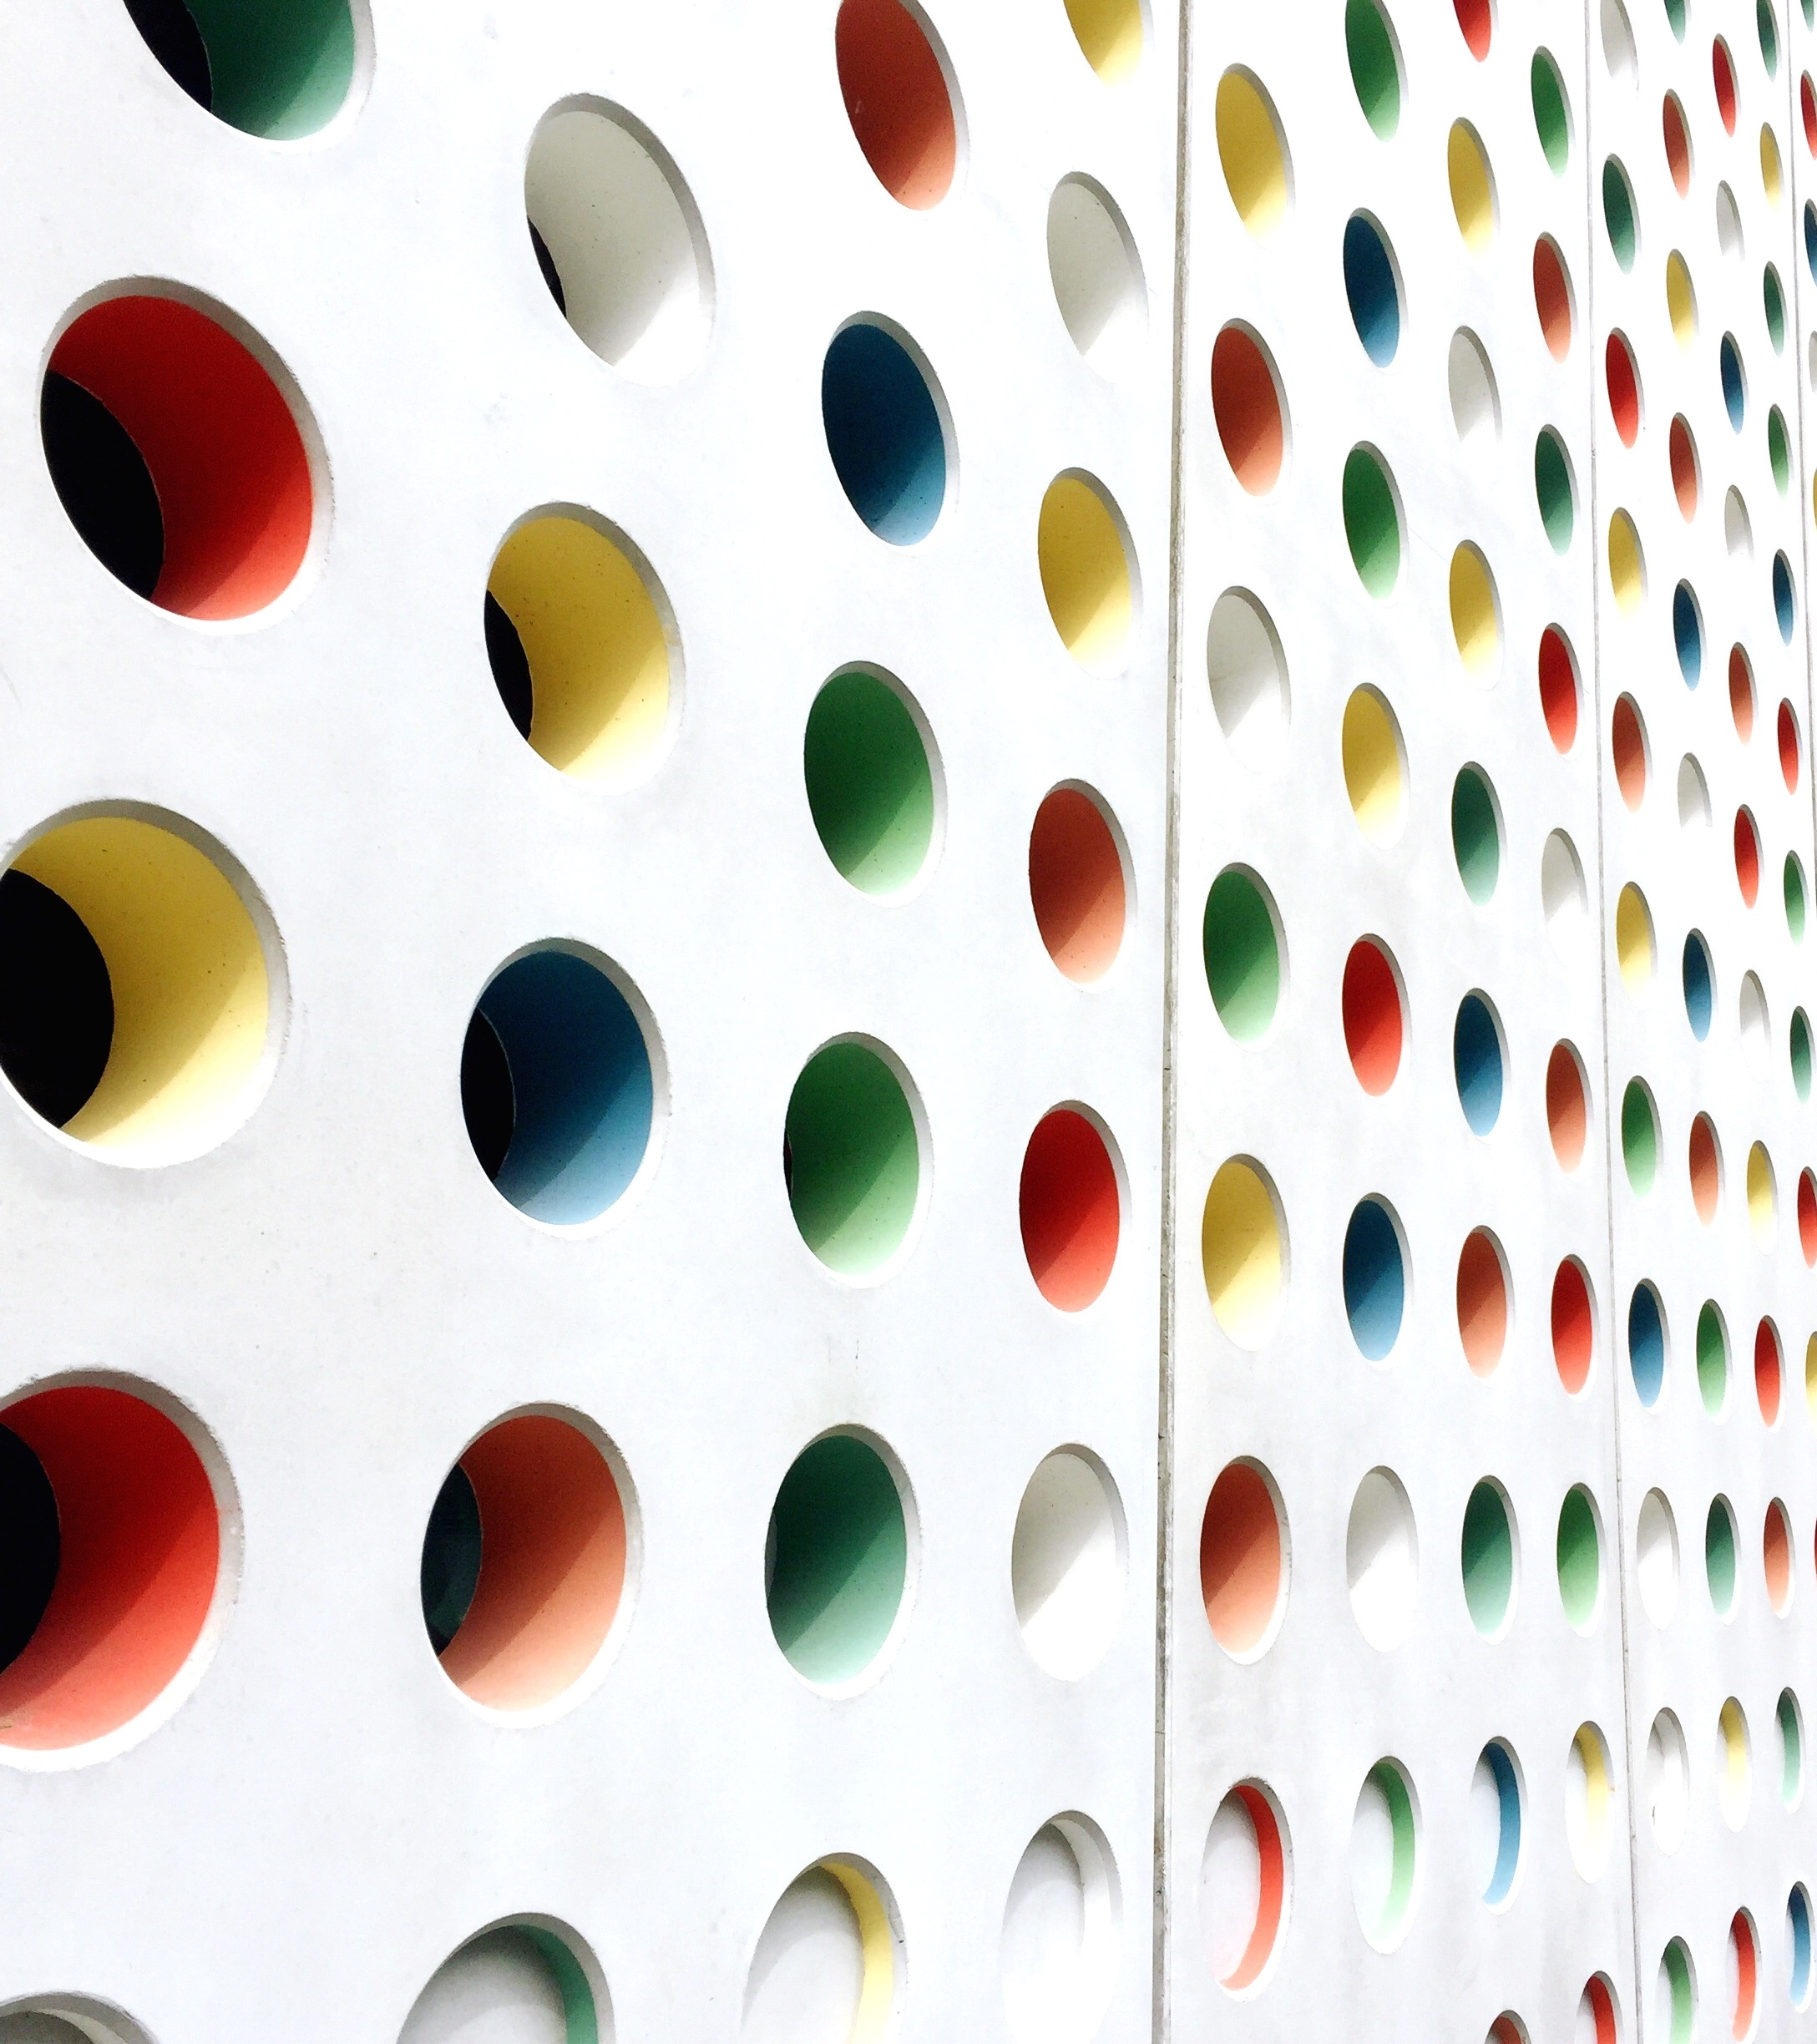
World Happiness Analysis
Group 1: The Eddies
4/20/23

Slide 2

Our Team
Peter Ferguson
Jessica Ferraro
Dave Freiberg
Nate Martinez
Kelsey Richards
(ft. Pharrell)

Slide 3
Our Approach
Pull and merge 8 years of historical country survey results
Determine multiple hypotheses
Plot and analyze data to determine correlations supporting our hypotheses

Slide 4

Data source and historical
SOURCE: World Happiness Report* The World Happiness report ranks 155 countries by their happiness levels, was released at the United Nations at an event celebrating International Day of Happiness on March 20th. The report continues to gain global recognition as governments, organizations and civil society increasingly use happiness indicators to inform their policy-making decisions.
*Foundational data is from the Gallup World Poll.
DATA SET:
2015 – 2022
FIELDS:
Country
Region
Happiness Rank
Happiness Score
GDP
Family
Life Expectancy
Freedom
Trust in Gov
Generosity
Dystopia Residual
DEV BRANCHES:
LIMITATIONS:
Survey is a snapshot in time as opposed to repeated questions over a period
Some data fields (e.g. 'Social Support') we not consistently collected every year
Sample sizes are small - only 1,000 respondents per country
“Happiness” may have different meanings from culture-to-culture.
Breaking our COVID years (’20& ’21) helped our analysis by making both sample sizes smaller.
Further analysis would be needed to determine if countries were consistently participating in the survey throughout all years
main
jessica
analysis
peter
dave
nate
kelsey

Slide 5

Happiness Ranking Hypotheses
We believe that the locations with consistently high happiness scores share common characteristics (eliminated).
Trust in each government correlates/contributes resident's happiness.
The extent of resident freedom correlates to resident happiness.
The level of government funded social support correlates to happiness (eliminated).
The level of happiness correlates to life expectancy and health.
GDP correlates to happiness.
ADDED: The COVID-19 Pandemic had an impact on happiness scores.
APIs (if we have time) (spoiler: we did not have time)
Layering in weather to see if there is a correlation to climate?
Layering COVID data to see the adjusted impact to global happiness

Slide 6

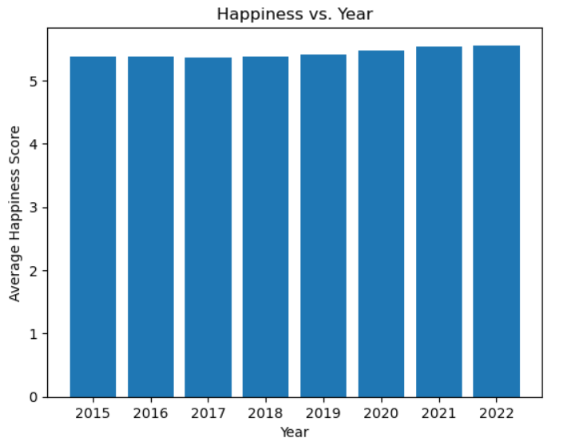
Effect of COVID on our Dataset
Hypothesis:
COVID-19 affects Happiness Scores in ’20 and ‘21
Analysis:
The COVID-19 Pandemic did not have a significant impact on overall world happiness.
We, however separated the years in the rest of our analysis to see if it affected specific data points

Slide 7
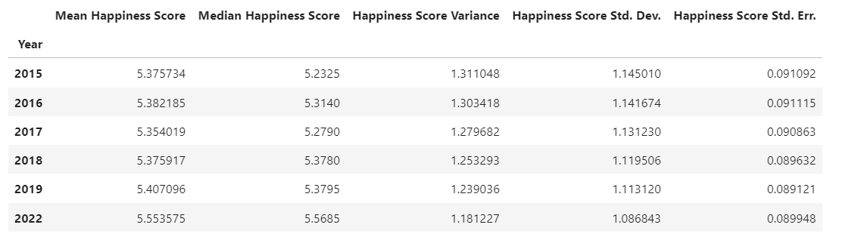
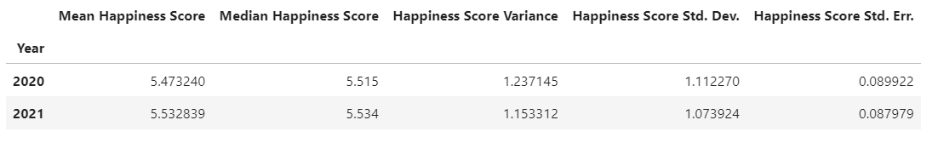
Statistical Summary of Happiness Score in Covid years and Non-Covid Years

Slide 8

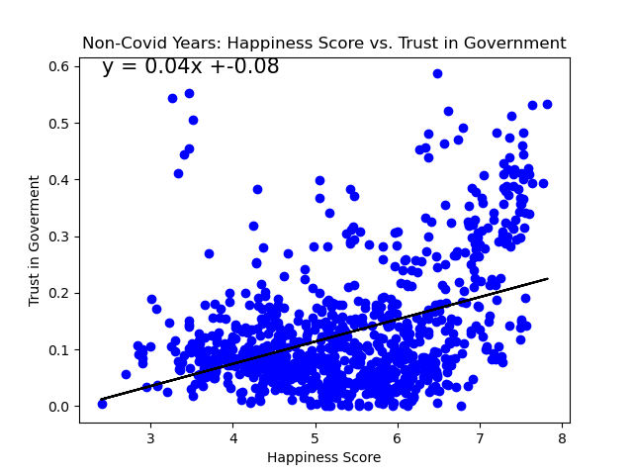
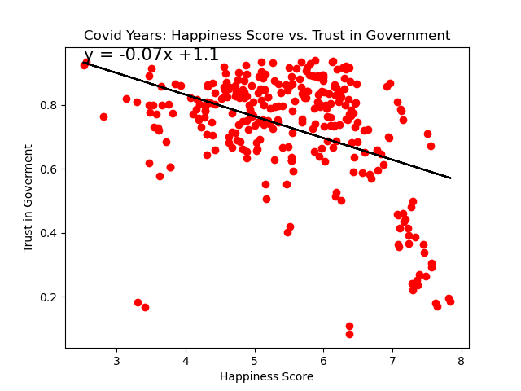
Trust in government correlates to happiness
Pre & Post-covid 2015-2019, 2022
Covid 2020-2021
Analysis:
Covid years had impact on “Trust in Government” scores. NOTE: We should take this with skepticism as the 2020/21 data sample was smaller.
We ran relative T-tests as the two fields were not mutually exclusive. The relative T-tests resulted in a 0.0 result.
Results were binary survey questions
null hypothesis cannot be rejected at the chosen level of significance.
R VALUE = 0.1607 | T-TEST = 0.0
R VALUE = 0.1761 | T-TEST = 0.0

Slide 9
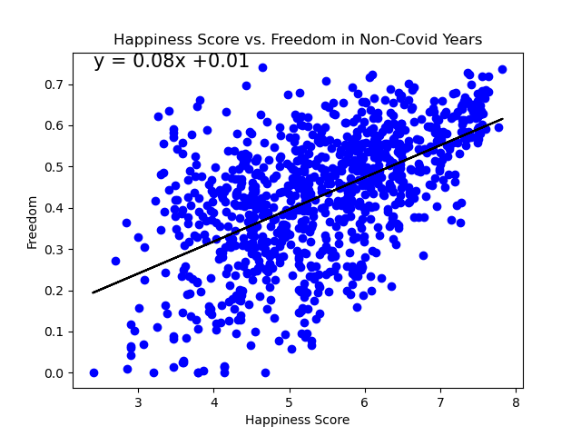
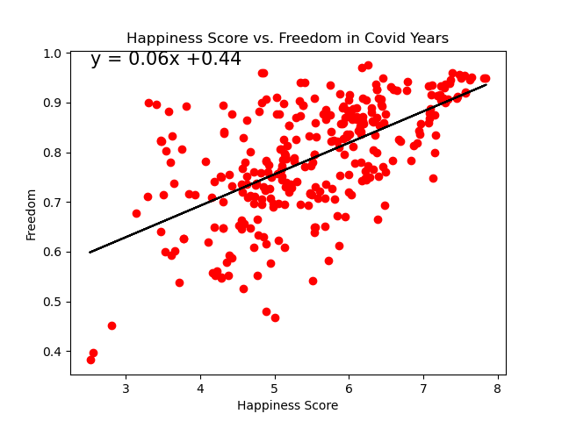
Individual freedom correlates to happiness
Pre & Post-covid 2015-2019, 2022
Covid 2020-2021
Analysis:
Covid did not have a significant impact on 'Freedom' score.
Linear regression shows a weak positive correlation between 'Freedom' scores and happiness.
T-test provided p-values near zero so the null hypothesis cannot be rejected at the chosen level of significance.
R VALUE = 0.31 | T-Test = 0.0
R VALUE = 0.36 | T-Test = 0.0

Slide 10
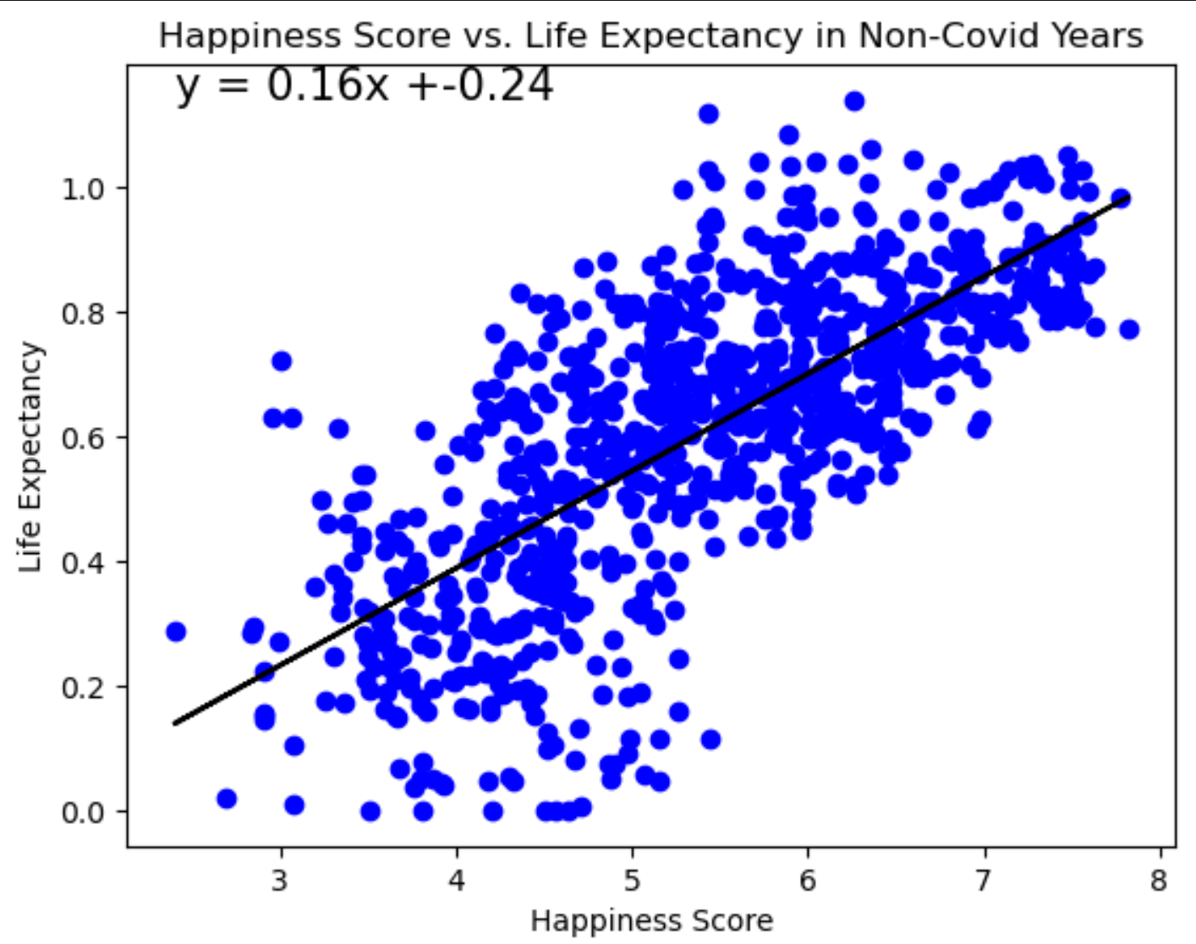
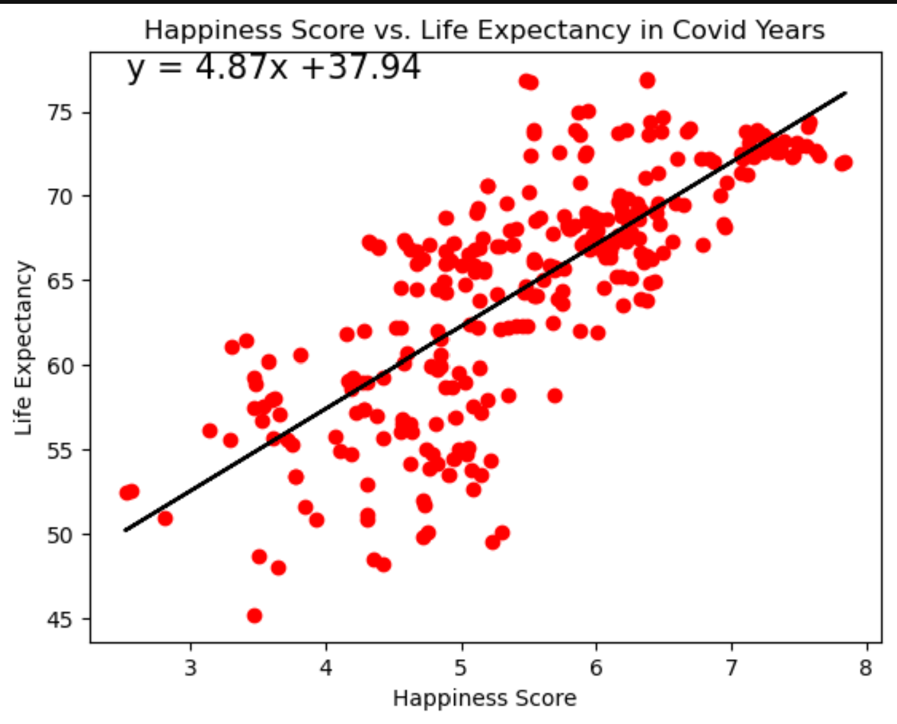
Life expectancy is tied to happiness
Pre & Post-covid 2015-2019, 2022
Covid 2020-2021
Analysis:
There is a correlation between a country's life expectancy and overall happiness score in all years
Countries with the highest life expectancies also have the highest
Note: WHO worldwide healthy life expectancy benchmark data not available for 2020 & 2021 years. Life expectancy per country is used instead, with similar correlation shown.
R VALUE =0.5397 | T-TEST 0.0
R VALUE = 0.5920 | T-TEST 0.0
*

Slide 11
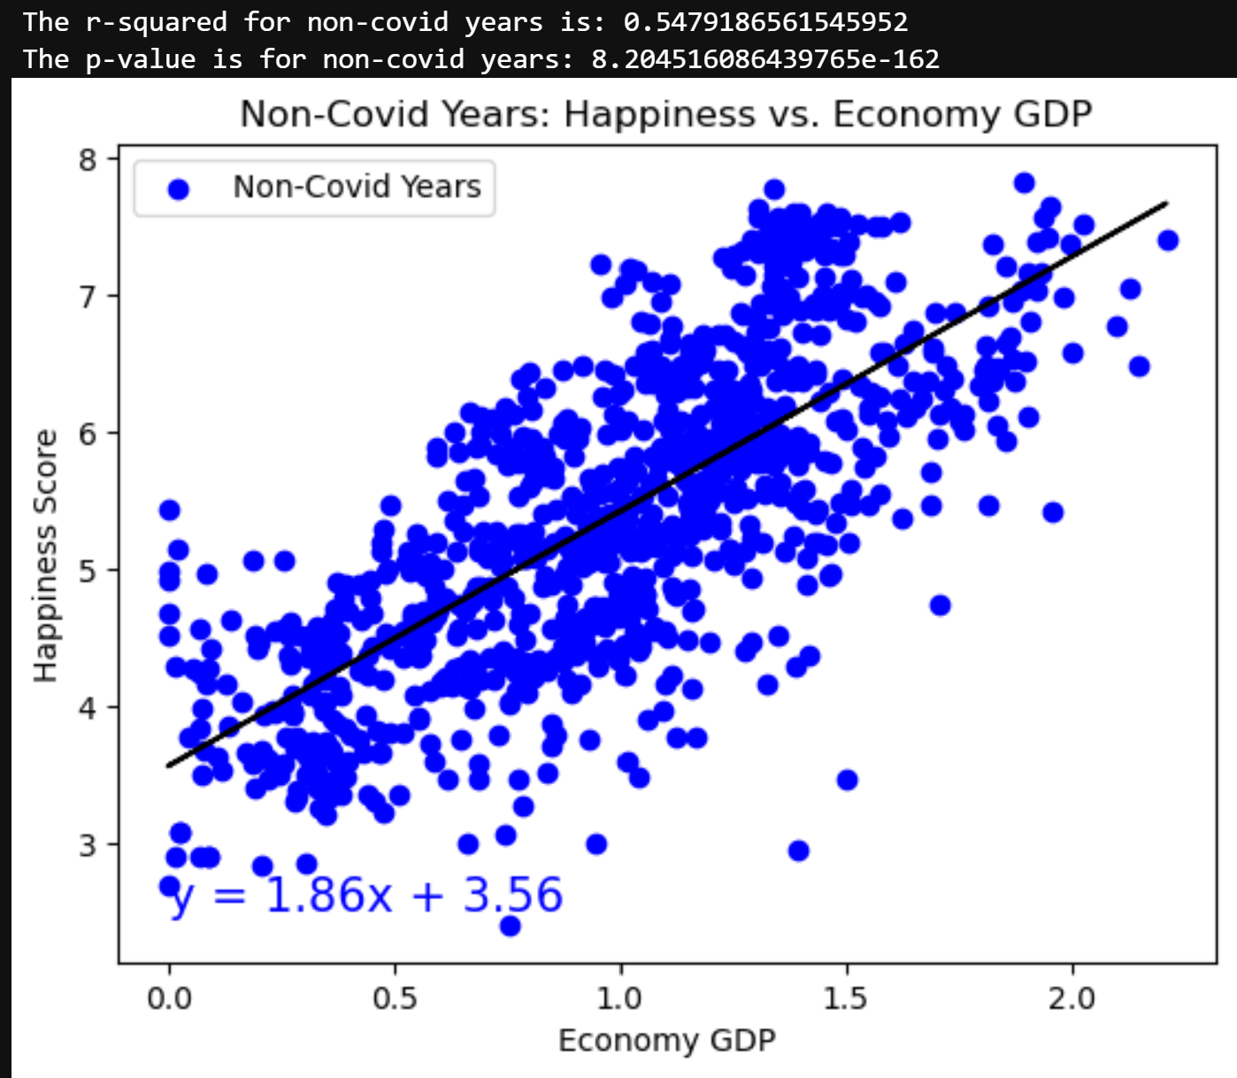
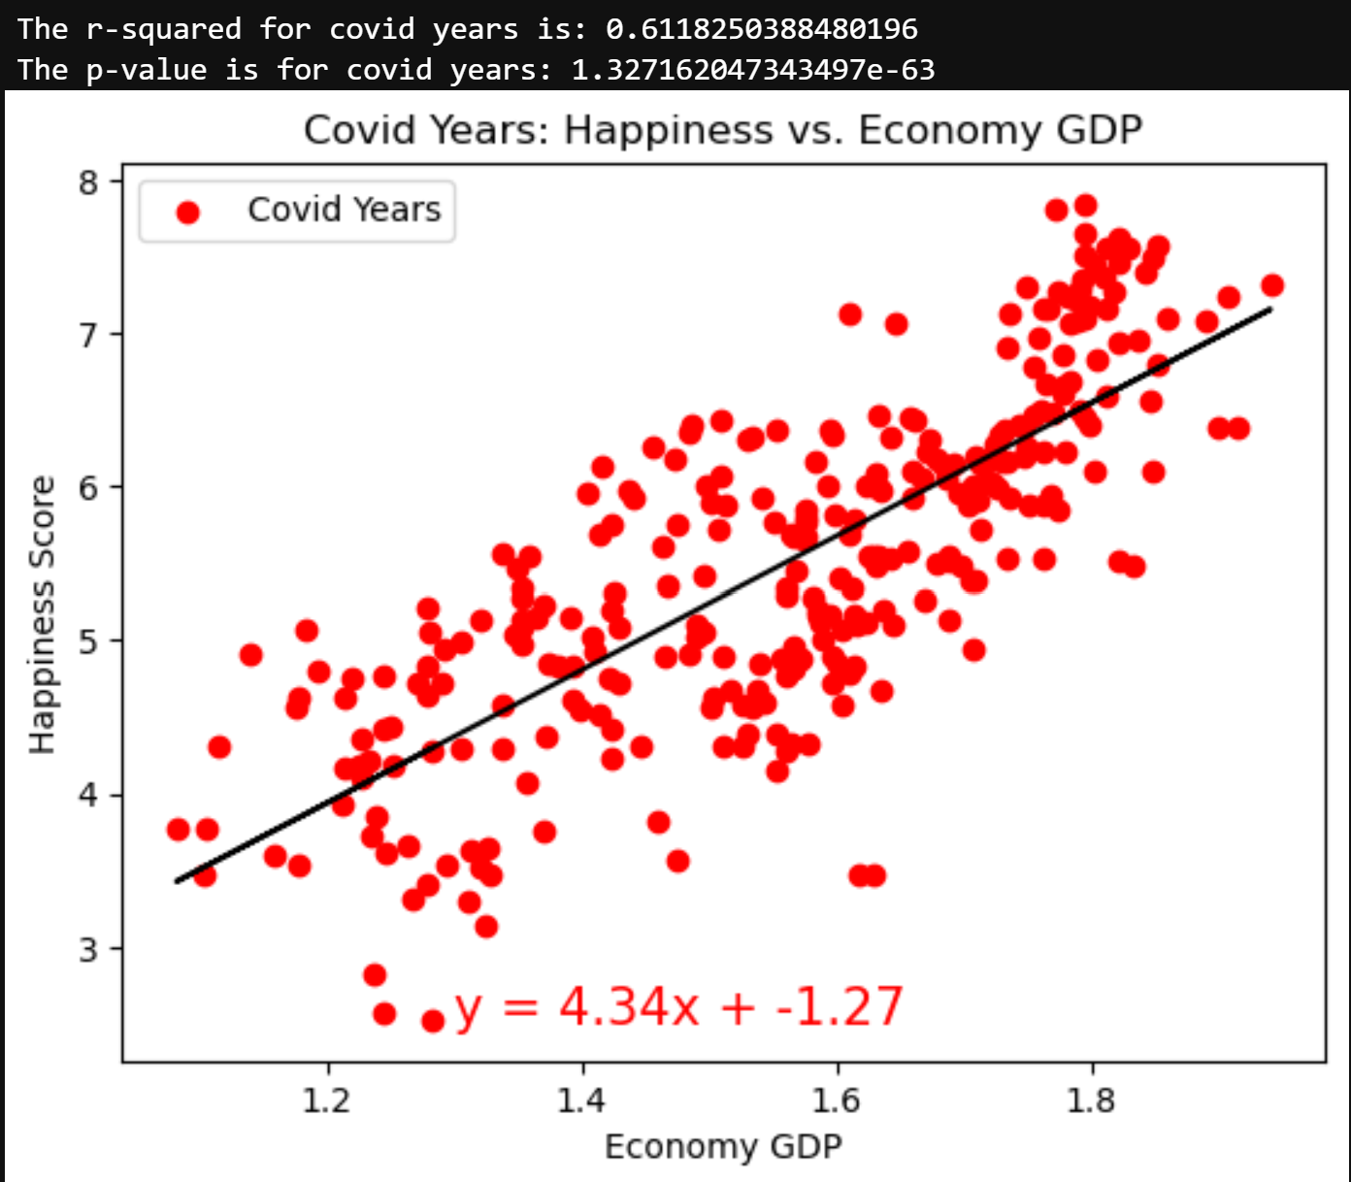
GDP correlates to individual happiness
Pre & Post-covid 2015-2019, 2022
Covid 2020-2021
Analysis:
For non-covid years, a 1 unit increase in the country GDP resulted in a 1.86 unit increase in happiness score.
During covid years, a 1 unit increase in the country GDP resulted in a 4.34 unit increase in happiness score.
Conclusion: GDP had a more significant impact on country happiness during the COVID-19 pandemic.
T-test provided p-values near zero so the null hypothesis cannot be rejected at the chosen level of significance.
R VALUE = 0.5479 | T-Test = 0.0
R VALUE = 0.6118 | T-Test = 0.0

Slide 12
In Summary
Hypothesis #1 (common characteristic by location) was too broad for the dataset, so we replaced it with the following hypothesis: The COVID-19 Pandemic had an impact on happiness scores. Comparing average annual happiness from 2015 to 2022 showed that the COVID-19 Pandemic did not have an impact on the overall world happiness.
Hypothesis #2 (trust in government) null hypothesis could not be rejected by statistical analysis. According to the scatter plots, the COVID-19 Pandemic reversed the relationship between citizens trust in government and happiness.
Hypothesis #3 (resident freedom) null hypothesis could not be rejected by statistical analysis. According to the scatter plots citizens' sense of freedom had a direct relationship with the country's happiness score. The degree of the direct relationship between the two stayed relatively consistent before and after the COVID-19 pandemic.
We did not test Hypothesis #4 (social support) due to inconsistencies in the category of data.
Hypothesis #5 (life expectancy) null hypothesis could not be rejected by statistical analysis. According to the scatter plots life expectancy in each country had a direct relationship with the country's happiness score. The degree of the direct relationship between the two was different before and after the COVID-19 pandemic, however, this is likely due to the difference in scale between covid and non-covid years data (actual years vs. Ratio). The scatter plots indicate life expectancy more significantly impacted country happiness outside of the COVID-19 pandemic years.
Hypothesis #6 (GDP) null hypothesis could not be rejected by statistical analysis. According to the scatter plots GDP had a direct relationship with the country's happiness score. The degree of the direct relationship between the two was different before and after the COVID-19 pandemic. The scatter plots indicate GDP more significantly impacted country happiness during COVID-19 pandemic years.

Slide 13

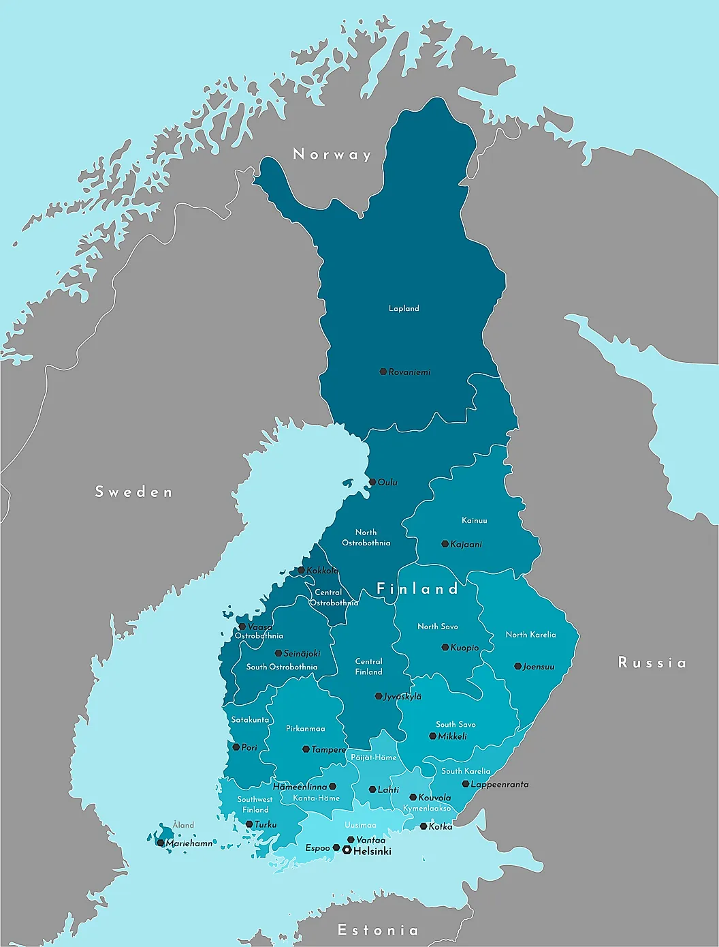

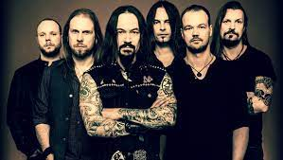
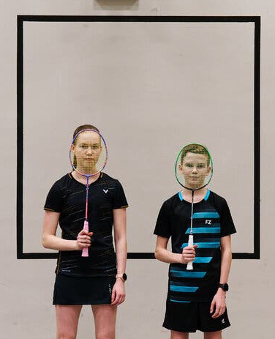
And the winner is...
FINLAND!!!!!! (4 years running as #1 happiness score)
“Finns derive satisfaction from leading sustainable lives and perceive financial success as being able to identify and meet basic needs, Arto O. Salonen, a professor at the University of Eastern Finland who has researched well-being in Finnish society, explained.
‘In other words,’ he wrote in an email, ‘when you know what is enough, you are happy.’”
The Finnish Secret to Happiness? Knowing When You Have Enough.
By Penelope Colston
Published April 1, 2023
Fun fact! Finland leads the list of countries by far with 53.2 heavy metal bands per 100,000 residents. Source

